Slide 1
Hands on training LOGO! 0BA7

Slide 2
News in LOGO! Soft Comfort V7

Slide 3
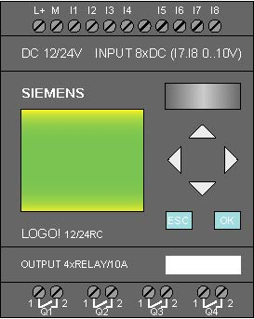

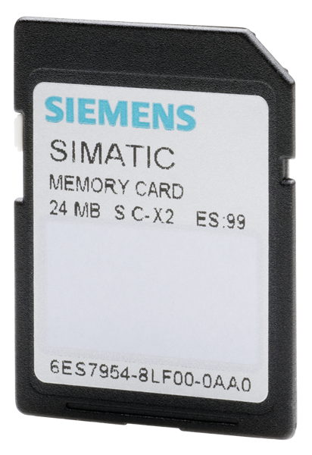
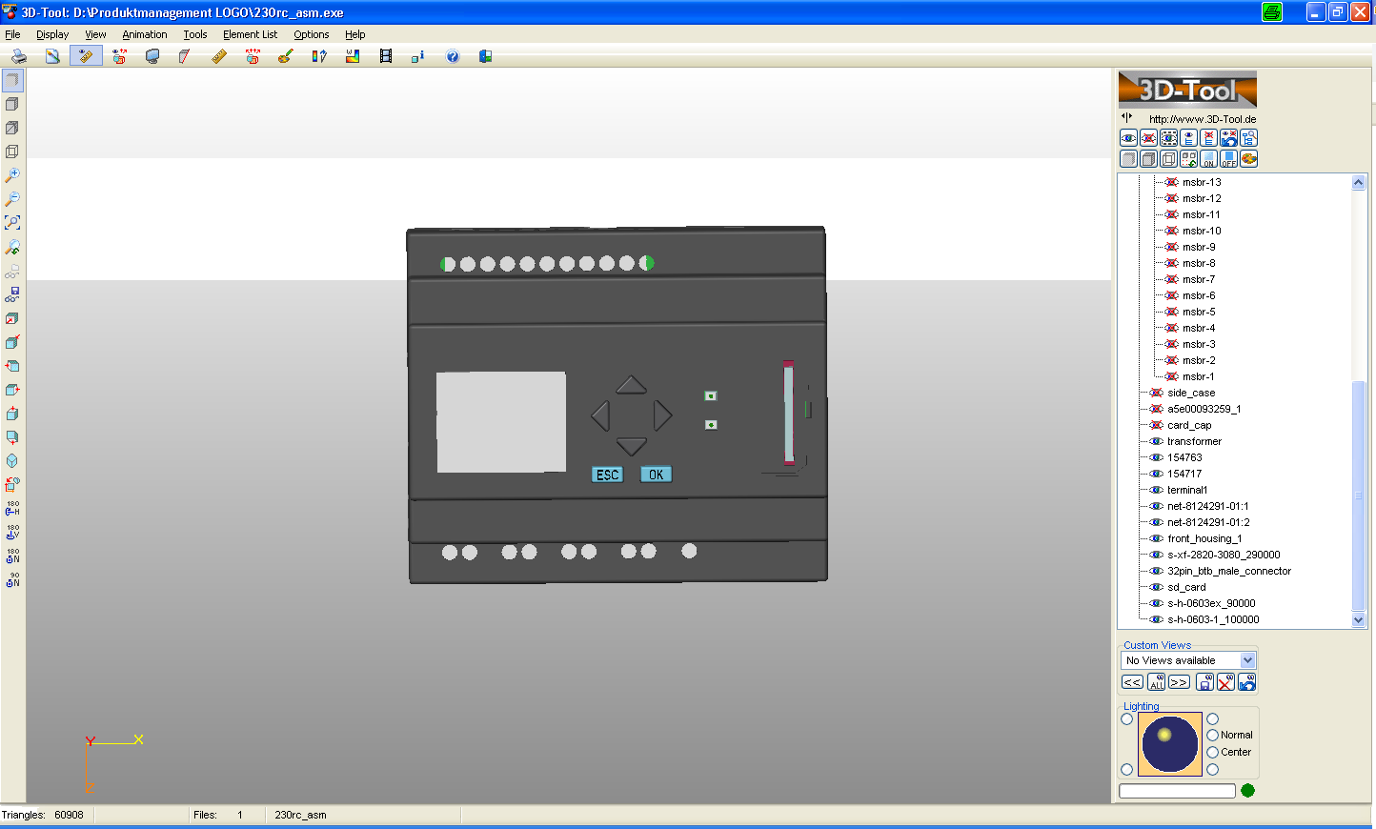

SD-Card Features
LOGO! 0BA7 with SD-Card offers the same features then the former LOGO! Memory card!
E
E
 | LOGO! To SD-Card | LOGO! Soft Comfort to SD-Card | Card Reader to SD-Card
LOGO! Program | YES | YES | YES
PW protection | YES | YES | YES
Knowhow protection | YES | NO | NO
Other files | NO | NO | YES

Slide 4
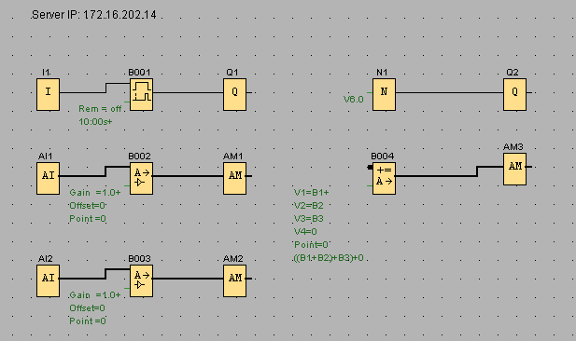
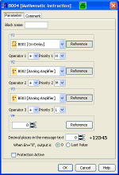
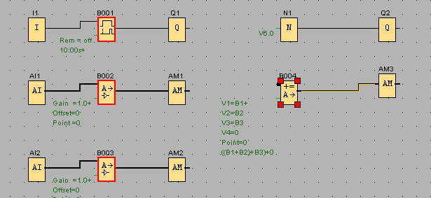
Show referenced FB’s
1
Select “select lines” and click on the FB.
All referenced FB’s will be highlighted
2
1
2
2

Slide 5
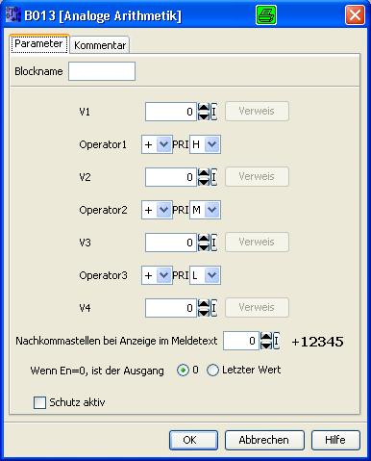
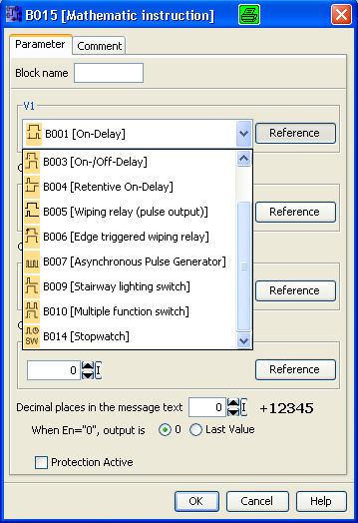
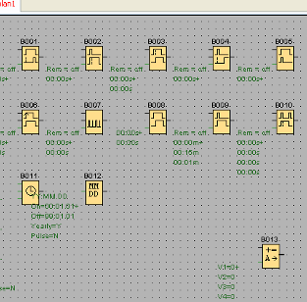
More referenced FB’s
Open both examples one with LSC V6 and LSC V7. Then open the properties of the Analog Math and check what FB’s you can select as reference.

Slide 6

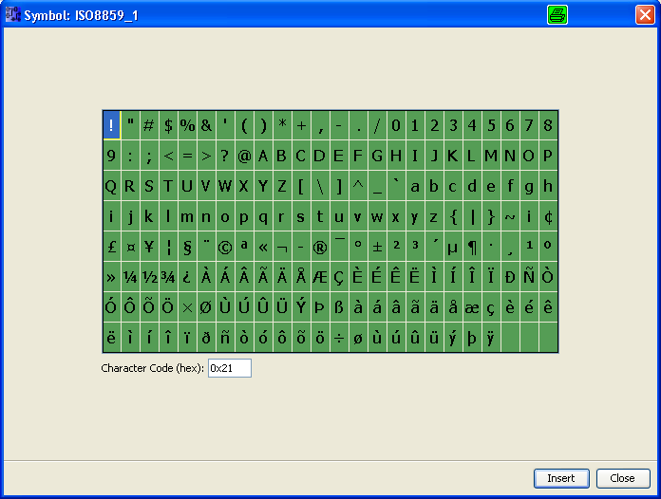
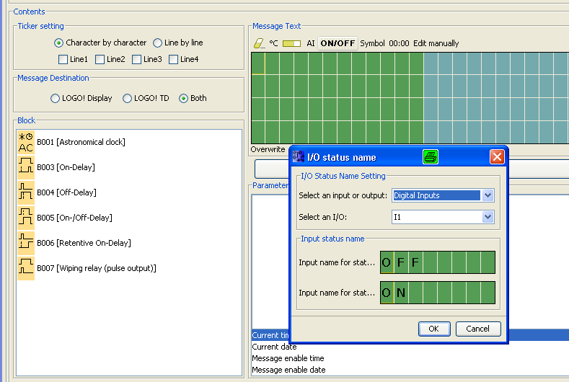
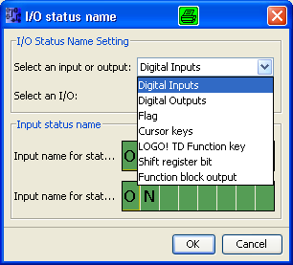
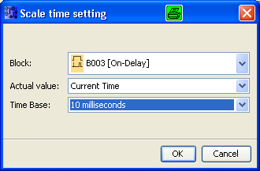
New for Text messages
4
2
1
3
4
2
1
1
3
1
More control for Status text
2
Virtual Keyboard for special characters
3
Change Value to Time for text messages
4
€ Character for each character set

Slide 7
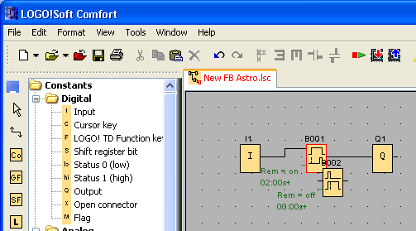
Function Block replacement
1
1
Function Block replacement:
RED Mark = Parameter different
GREEN Mark = Parameter similar

Slide 8
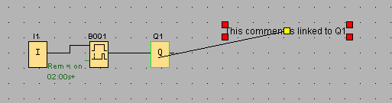
Link comments to function blocks
1
You can now “link” one or more commenta to any function block
If you then move the function block, the comments will also move

Slide 9
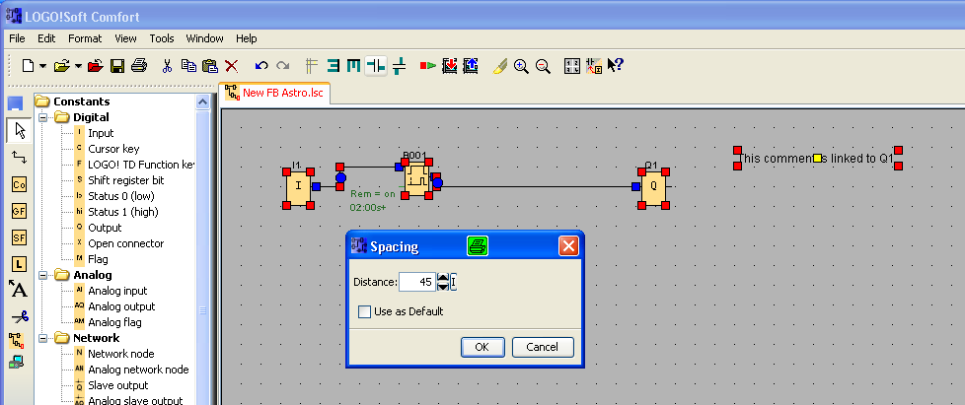
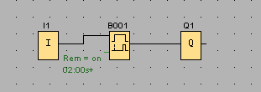
Alignment of function blocks
1
2
2
1
3
Horizontal & vertical spacing
2
Select the space between the function blocks
3
Result: All function blocks in a line with similar distance

Slide 10
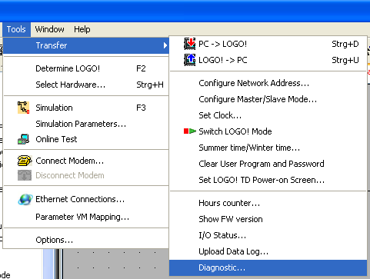
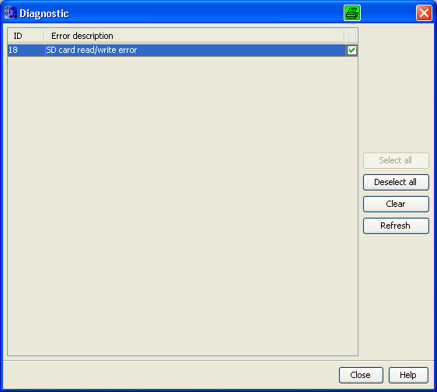
Diagnostic with LOGO! Soft Comfort V7
2
3
1
1
Select Tools; Transfer; Diagnostic
2
After the upload you will find error information in the Diagnostic window
3
Here you clean errors or refresh

Slide 11
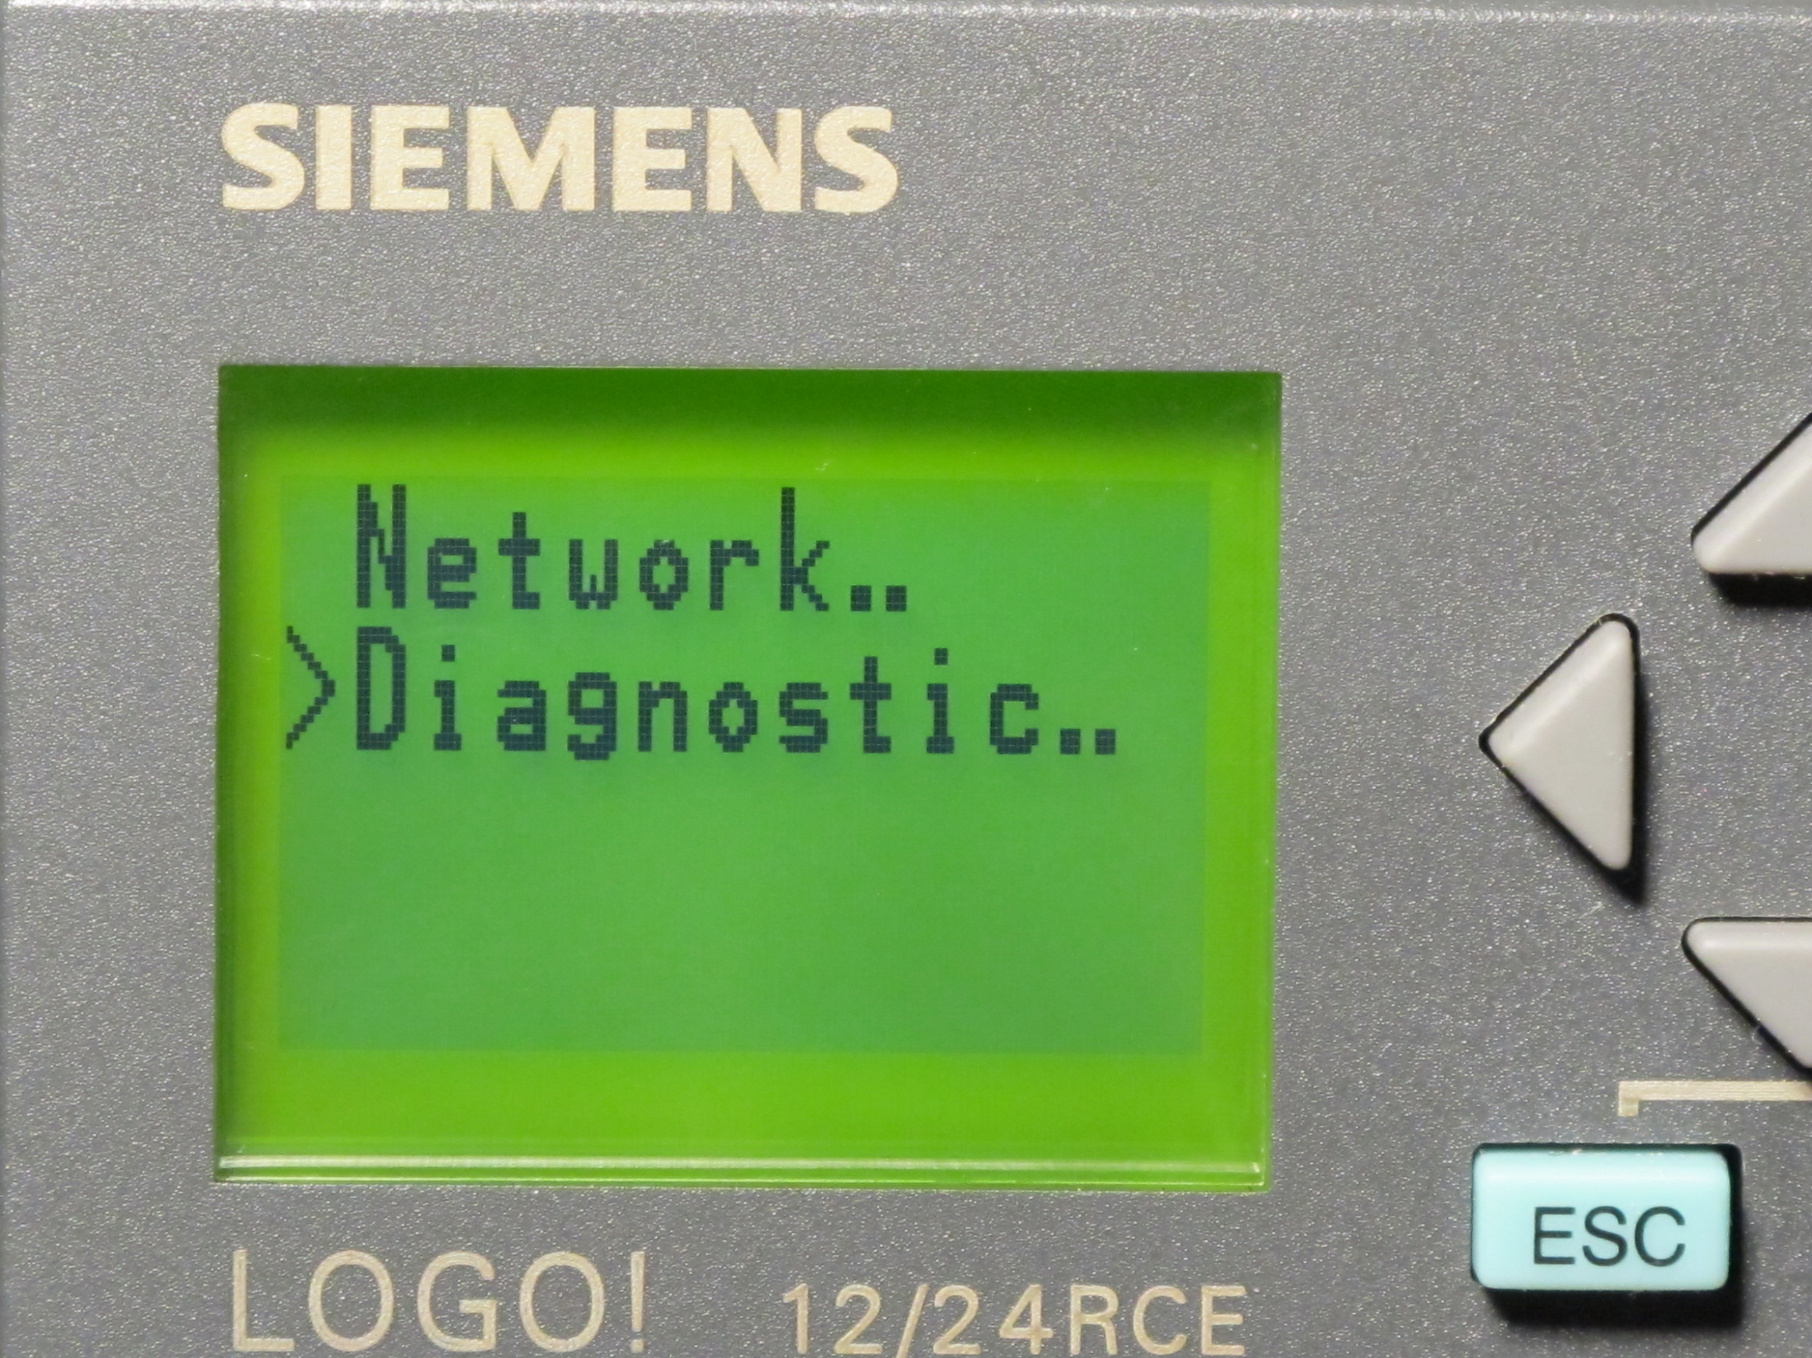
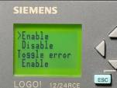
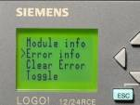
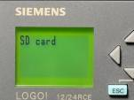
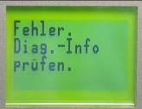
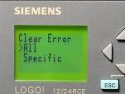
Diagnostic on a LOGO! 0BA7 base modul
3
4
1
2
5
1
Enable “Toggle Error” to display errors on the display
2
Error message on the display
3
Go to Error information in the diagnostic menu
4
Detailed Error description
5
Select “Clear error” and delete specific or All errors

Slide 12
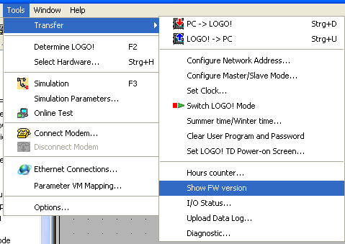
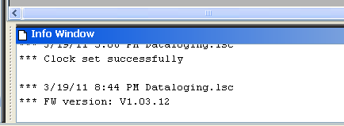
Show information with LOGO! Soft Comfort V7
2
1
1
Select Tools; Transfer; Show FW Version
2
After the upload you will find the FW version in the Info Windows of LOGO! Soft Comfort V7

Slide 13
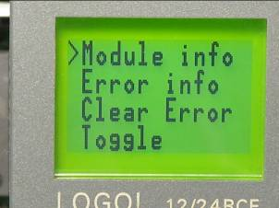
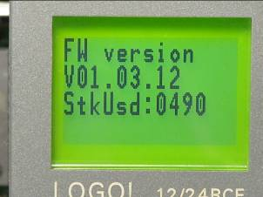
Show information on a LOGO! 0BA7 base modul
1
2
1
Select Module info
2
Then the firmware version will be shown on the display

Slide 14
Networking wiht LOGO! 0BA7 V1
Thank you for your attention!
H. Schindler
I IA AS FA PS4
Phone: ++49 (0)911 / 895 - 3665
E-Mail: Helmut.schindler@siemens.com

